Slide 1
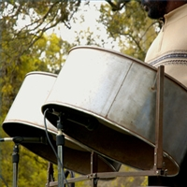
Calypso
Origin?
  Trinidad & Tobago
  Africa?
Purpose
  Stories
  Mocking
  News
  Express emotions
http://ilovemusicpop.com/wp-admin/calypso-music-facts&page=2

Slide 2
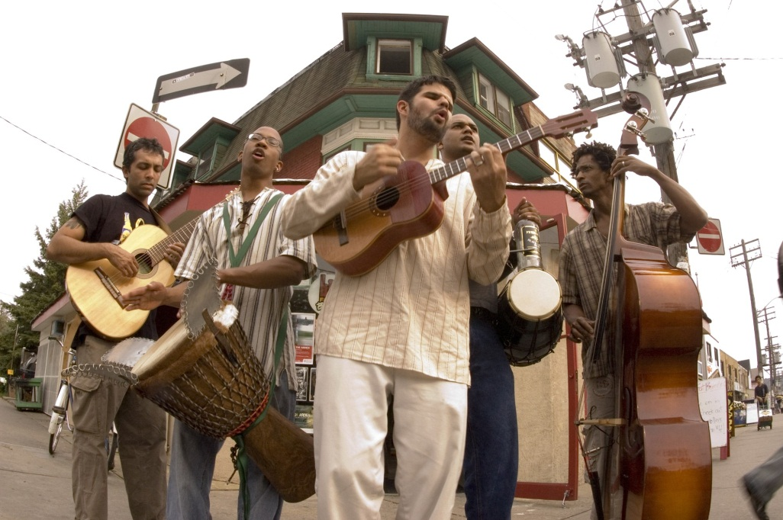
Calypso (Cont.)
Musical Instruments
  Oil Drums
  Steel Pans
  Guitar
Modifications
  Bands came together
  Rubber bands
http://thefestival.bc.ca/archives/166

Slide 3
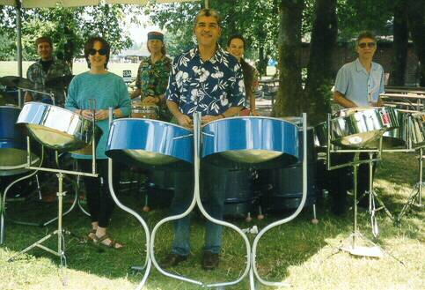
Calypso (Cont.)
Current State
  Hard to learn
  Instruments need to be improved.
  Not mainstream.
  The experience is still alive.
http://home.comcast.net/~bkitchel/images/jpegs/ray.jpg

Slide 4
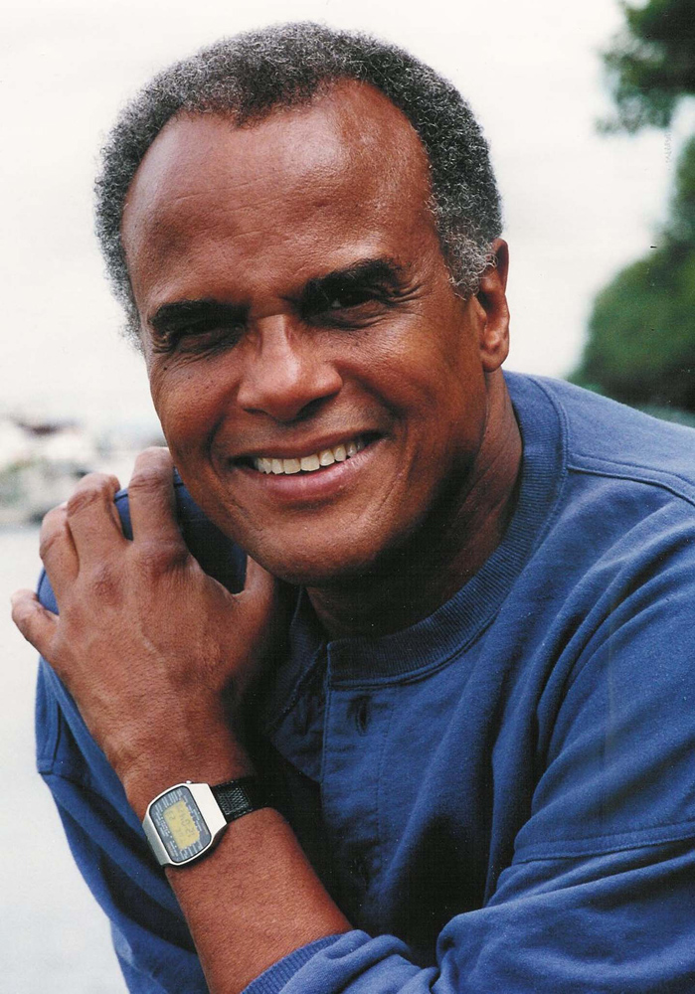

Calypso (Cont.)
Henry Belafonte
http://charlespaolino.wordpress.com/2009/12/15/and-in-a-manger-cold-and-dark-marys-little-boy-was-born-jester-hairston/

